Slide 1
Clause Template Configuration
July, 2013

Slide 2
Agenda
This presentation will:
  Outline the Clause breakdown process
    Usually, the starting point for this process is an actual Word document contract used by the customer.
    The task is to map that document to ECM constructs.
  Provide Contract Template optimization tips
  Outline steps to configure a Format Template

Slide 3
Contract Template Components - Clauses
Clause Library
Contract Template
Contract Creation
1. ----------------------
-------------------------
-------------------------
-------------------------
-------------------------
Clause 1
Clause 2
Clause 3
E.g.
Payment Appendix
Fee Schedule
1. ------------------------
---------------------------
---------------------------
---------------------------
2. ------------------------
---------------------------
---------------------------
---------------------------
3. ------------------------
---------------------------
---------------------------
---------------------------
2. ----------------------
-------------------------
-------------------------
-------------------------
-------------------------
Virtual Document
---------------------------------------------------------------------------------------------
3. ----------------------
-------------------------
-------------------------
-------------------------
-------------------------
Terms
Track changes
Events & Notifications
Attachments
Approval Chains
Term Sheet (Summary)
Contract Lines
Notes
Activity History
On-line Search
Reporting
Etc.
4. ----------------------
-------------------------
-------------------------
-------------------------
-------------------------
Alternate
Names / Dates
Amounts / Quantities
Time Periods (Days, Months, etc.)
Payment methods
etc.
Notes:
The clauses stored in the “clause library” are the building blocks of the Contract Template. This includes standard clause language as well as any applicable alternate clauses.

Slide 4
Clause Templates – Concepts
Clauses
Similar to legal paragraphs that make up a contract (all contract language is contained in clauses)
When deciding on defining a clause, factor in:
  Formatting and reuse. N text paragraphs that are always used together should be combined into one clause, unless they require different formatting. A clause (clause template) consists of one Clause Title and one Clause Body, each with an assigned formatting style from the organization's Format Template. These styles can be overridden when the clause is added to a contract.
  Approval needs. Clauses can be defined as needing approval or not.
  Security needs (restrict editing or visibility). [You may not want to mention this unless the client specifically asks for it, because it's painful to implement.]
  Usage of the same clause in multiple contract types. This tends to be forgotten.
  Possible replacement of clauses by terms, since a term can have 1000 characters.
  Use of Alternate Clauses.

Slide 5
Clause Templates – Concepts, cont.
Each clause body can only have one style.
Clauses may contain Terms
The collection of clauses is referred to as the clause library
A contract template is made up of many clause templates

Slide 6
Clause Template Considerations
There is an “unofficial limit” of approximately 200-300 clauses per contract
  Beyond this, performance can start to degrade
  Every clause is a separate object in the repository database; to open a contract with 100 clauses in the Contract Editor requires 100+ database retrievals
  Try to minimize number of clauses, but within reason. However, users can often be lazy and want to add text to existing clauses, even where a new clause makes more sense.
It is very important to have as simple as possible Word usage in contract language
  Doing this will minimize rework if Word, Word styles, etc. change
  Tab instead of multiple spaces
  Appropriate paragraph settings; e.g., indent in paragraph definition instead of using a tab to indent the start of every paragraph
  In Word, use the “Show Paragraph Marks” icon (resembles backwards “P” in the Paragraph area) to show paragraphs, tabs, etc.

Slide 7
Clause Template Considerations (cont.)
Each Clause Title and Clause Body are separated by a Word Bookmark
  In Word Options / Advanced, check the “Show Bookmarks” option, then Save
  A bookmark resembles a large grey “I” within a document
  A bookmark is also used immediately before and after each Term in a clause
  A special case is a “range bookmark” which marks the start ([) and end (]) of each clause
  Be very careful not to delete a bookmark when editing a contract
Nontrivial amount of Word skill is required to optimally implement contract definitions in ECM
See the Configuration and Formatting Guide for details on proper use of Word with ECM

Slide 8
Clause Template Breakdown
Template Breakdown Process
  Identify Key Components of a Clause
    Language (including any alternate language)
    Terms
    Clause Type (This is just a name, for classification and searching purposes, like Contract Class. Managed via Administration > Standards > Clause Types.)
    Formats
    Approvals
    Security
  Populate the Design Spreadsheets
    Term Master
    Clause Master
    Contract Master

Slide 9
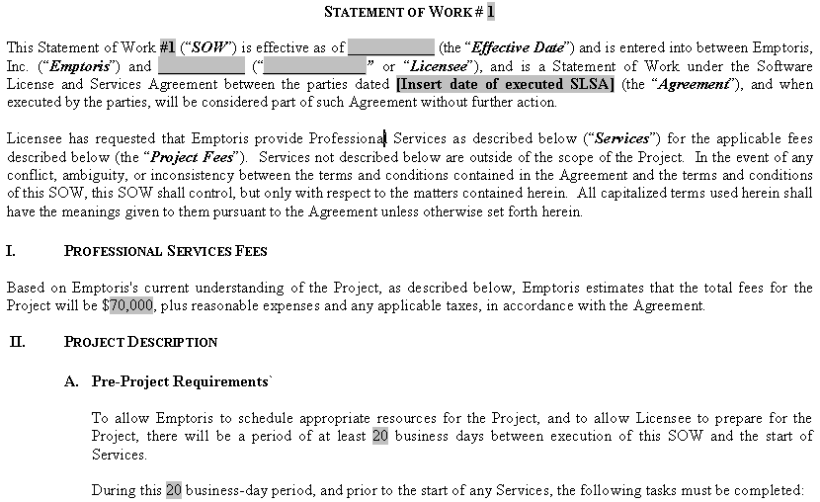
Contract Decomposition
Title
Body
Clause 1
Title
Clause 2
Body
Title
Clause 3
Body

Slide 10



Contract Decomposition
Original Contract Breakdown

Slide 11
Clause Decomposition
Build the Clause Master spreadsheet
You may not want to bother filling in the Language Body column, because its contents will be quite large.
  Instead, you can copy the text from the client's sample contract when creating the clause template.

Slide 12
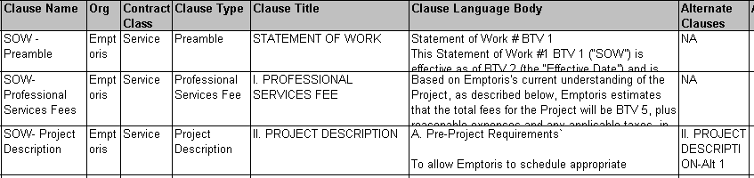
Clause Template Breakdown
Build the Clause Master spreadsheet

Slide 13
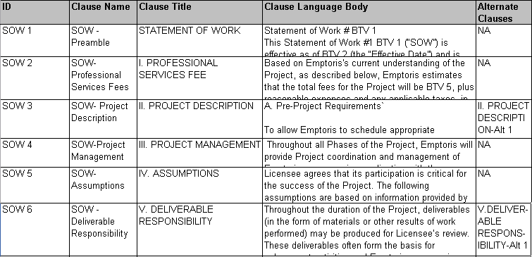
Identify Approvals & Alternates
Define Approvals at the Clause level
Define Alternate Clause list

Slide 14
Breakdown Tips
Clause Template Consolidation
  Leverage Clauses on multiple contract templates
  Utilization of Alternate Clauses
Establish Standards
  Formatting Style
    Clause Title, Clause Body, Terms, etc.
  Approvals
  Notifications: System & Custom Events
Effective Use of Terms
  Leverage System Terms
  Use Custom Properties
  Use of Tracking Terms for internal metrics
Use of Guidelines & Notes
  Empower your users
  Use consistent naming conventions for ease of location by the end user.

Slide 15
Clause Master Preparation
Assign clause properties
  Title
  Guidelines for use
  Applicable organizational use
  Language
Set style (formatting) for Title and Body
Add Language
Set Approvals
Enter Effective Dates for lifecycle of the clause template
  Good source: ECM online help, under topic “Introduction to Administration” (not in PDF)

Slide 16
Clause Template Creation
To be clear: we're talking about Language Clause templates (not Line Clause Templates, which are discussed in a later presentation)
Administration > Standards > Clause Templates
Assign clause properties from the Clause Master spreadsheet, as appropriate
  including Title and Body styles, Language, Alternate Clauses, Approvals, Effective Dates
Adding Language:
  DO NOT directly copy from the model Word document (contract) into the Clause Editor, because undesirable formatting will be copied over
  Instead:
    copy the entire model contract into Notepad
    cut (or copy) and paste text representing a clause from Notepad into the Clause Editor
    apply style(s) from the ECM Format Template (next slides)
    continue cutting from Notepad for the language of subsequent clauses

Slide 17
Alternate Clauses
When you define one or more alternate clauses, it's easy to choose an alternate instead of the default in a Contract in Draft or In Negotiation status.
Be sure to choose/define alternate clauses such that if one is chosen, the user will not need to change the Title or Body style when applying the alternate (incorrect choice may get made)

Slide 18
Demonstration: Clause Templates
Follow along ….
Use BUM or Admin user; Administration > Standards > Clause Templates
Start by listing (searching for) all existing Clause Templates
Open one and look at its properties
Open the template language and make sure the Emptoris ribbon appears
Notice that the Language Editor is disabled while the Word Editor is open
    Note: Do not have Word already open when opening the Word Editor in ECM
Position the cursor in the clause and insert a Term.
Optionally save the template (one will be created in a later exercise)
Suggest always prefixing new object names/labels with your initials

Slide 19
Format Template Preparation
A Format Template is a Word .docx file containing all of the formatting styles and establishes other attributes for the contracts owned by a particular ECM Organization. (The same Template can be used for multiple organizations, but must be uploaded separately to each.)
  Only one is allowed per Organization. Child Organizations inherit from their parents if needed.
  Default is supplied with ECM (but may have been changed during configuration); to download it: Administration > Application > System Settings > Language Tab. Click link to open it, then Save.
  Chances are good that the default does not include all the styles needed for an organization, so you will need to either add styles to it or (more likely) replace it entirely
    To determine the styles used in an existing contract, open it in Word, and select some text. In Word 2007, in the Home / Styles area at the top, the style in use for that text will be highlighted. To open the Styles pane (on the right), click on the arrow in the bottom right corner of the Styles area at the top.
    (To check the styles in an existing Clause Template, use Administration > Standards > Clause Templates > (search for appropriate templates) > open the template, click on the Language tab, then the Open link to open the language in Word, and follow the steps in bullet above)
  After you have your final Format Template (details later, and in the Configuration and Formatting Guide), upload it to ECM via Administration > Application > System Settings > Language > Format Template > (Select Organization) > (Select Template File)
    Uploading a new version of the Format Template does not automatically affect existing contracts, but the new version will apply to contracts created later

Slide 20
Format Template Preparation (cont.)
The Format Template sets style (formatting) for
  Contract title
  Clause titles
  Body text, including font and size, auto numbering, indentation, bold/italic, ...
  Page size and margins
  Tables in Line Clauses (new in V10.0.1; additional material later, in discussion of Lines)
Defines Contract Header and Footer
  Logos
  Contract Values
Demonstration:
  Setting up a Format Template requires good Word skill, and many implementers are required to do it
  Depending on your needs, you may want to execute many of the steps in the next slides
  Coordinate with those sharing the same Organization before uploading a new Format Template
  For now, we will simply open the supplied Format Template in Word (outside of Emptoris) and show how the different styles are used.

Slide 21
Format Template: Adding a New Style
In Format Template, add a new style to the Word template (see also next slides)
  Best practice is to:
    Name styles uniquely and in a meaningful way, with conventions such as “Level1_Arial10” (level, font, size) or “Numbered Second Level with Uppercase Roman Numeral” or “Table Style 1 for Product Lists”.
    Add at least one Table style, using a prefix such as “Table” or “Tbl” for each.
    For non-Table styles, enter text matching the style name and apply the style to it
Add style name to LanguageStyle value list:
  Administration > Configuration > Value Lists > LanguageStyle
  The style names are case sensitive and can contain only letters and digits
  After all styles have been added, upload the Format Template to ECM (see earlier)
Notes:
If you aren't familiar with Word styles, we suggest practising outside of Emptoris, but you may wish to download the supplied Format Template and play with that
It is recommended to use the same version of Word for editing all Format Templates and Clause Templates.
When upgrading to a new Version of Word, it is recommended to do a dummy edit of all Clause Templates and Format Templates to minimize the chance of inconsistencies.
Notes:
Type a few words so you can see the effects of what you’re doing
Format those words – Word automatically creates a style
Open Styles and Formatting pane
Modify the style just created
– enter meaningful name
- apply additional formatting if desired

Slide 22
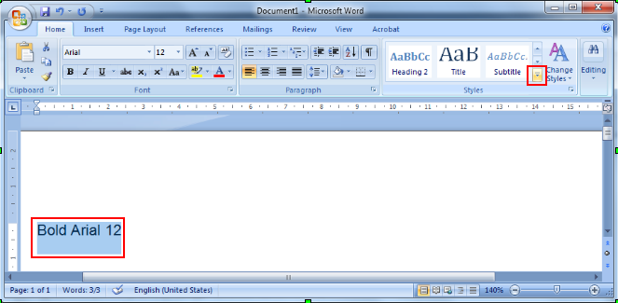
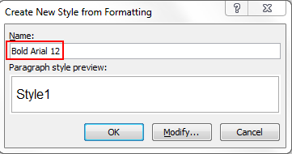
Adding a New Style (non-Table)
Open Format Template document in Word
Enter text describing the style to be created; format appropriately
[Word 2007] Select text; click on “More” arrow in Styles group; choose “Save Selection as a New Quick Style”; name style to match text; OK
To change a style, right click on it in the Styles group; Modify; make the changes; OK. (Or select text; “Update <style> to Match Selection”).
Save Format Template as .docx, upload to Contract Management
Add style name to LanguageStyle value list
Notes:
Type a few words so you can see the effects of what you’re doing
Format those words – Word automatically creates a style
Open Styles and Formatting pane
Modify the style just created
– enter meaningful name
- apply additional formatting if desired

Slide 23
Adding a New Table Style
(Table Styles are needed to exploit the new Lines support in V10.0.1)
Open Format Template document in Word
[Word 2007]
  Method 1: Insert a table; Table Tools > Design > choose existing style; “More” arrow > Modify Table Style; rename the style for ECM (e.g., “Table ___”) and make additional changes if desired
  Method 2: Home > Styles > open Styles pane; New Style icon at bottom; name the style, change Style Type to Table, set table formatting as desired
Save Format Template as .docx, upload to Contract Management
Add style name to LanguageStyle value list
Notes:
Type a few words so you can see the effects of what you’re doing
Format those words – Word automatically creates a style
Open Styles and Formatting pane
Modify the style just created
– enter meaningful name
- apply additional formatting if desired

Slide 24
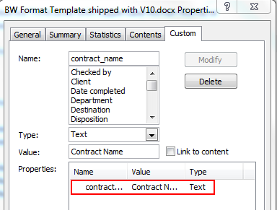
Format Template: Configure Header & Footer
Include a Term (System or Custom) in the Header or Footer
Find the Name of the term to be included (in ECM: Administration > Standards > Term Definitions > (search for the Term)
  e.g., Term Name is “contract_name” for the Term with Label “Contract Name”
(We are still editing the Format Template document.) [Word 2007] Microsoft Office button > Prepare > Properties > Document Properties > Advanced Properties
In the Document Properties dialog, go to the Custom tab. In the Name field, enter the Term name; for Type, use “Text”; the Value field is for debugging only, so you may wish to use the Term Label. Click Add. After you do this, the property will be added in the Properties area at the bottom; if you select a property there, you will be able to modify or delete it. Click OK to exit the dialog.
(continued)
Notes:
see Emptoris Contract Management User Guide for a complete list of system terms.

Slide 25
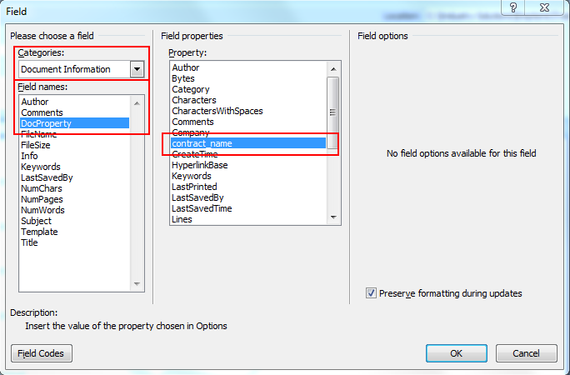
Format Template: Configure Header & Footer
Include a Term (System or Custom) in the Header or Footer (cont.)
[Word 2007] Insert > Header & Footer > Footer > Edit Footer
Click at the position in the footer where you want to add the Term.
[Word 2007] Insert > Text > Quick Parts > Field. In the Field dialog, choose Categories = Document Information; then in “Field names”, choose DocProperty. Under “Field properties”, select the property you added for the Term; e.g., contract_name. Click OK. The Value you entered for the Term property should now be shown in the Footer, but it will be replaced by the Term value in contract instances.
Note: For V10.0.1 this procedure is documented in both the Configuration and Formatting Guide, and the Administration Guide, but the latter is a bit clearer.
Notes:
see Emptoris Contract Management User Guide for a complete list of system terms.

Slide 26
Format Template: Configure Header & Footer
Add Logo to Footer (or Header)
(We are still editing the Format Template document.) [Word 2007] Insert > Header & Footer > Footer > Edit Footer
Click in the position where you want the logo to appear
Insert > Illustrations > Picture > (browse to and select logo file)
Notes:
You can only place the logo in header or footer.
The logo file should be smaller than 10K in size to avoid possible performance issues.
Supported formats are .bmp, .eps, .jpg, .tif.
By default, the header and footer in a Format Template apply to all contracts for the organization. This can be overridden by having a different header/footer defined in a clause template; it will take effect for the contract at the point of the clause template.
Notes:
see Emptoris Contract Management User Guide for a complete list of system terms.

Slide 27
Auto-Numbering
Auto-Number Clause Title
Create and apply auto-numbered style to Clause Title on Clause Template Properties tab
Auto-Number Clause Body Text
Create and apply auto-numbered style to Clause Title on Clause Template Properties tab
  Every paragraph in clause body will be numbered
  Use soft returns within Clause template language where numbering should not apply; OR
In Clause Template Language
  Format > Bullets and Numbering > Numbered
  Multiple kinds of numbering can be applied within clause body
Note: do not attempt to apply Word styles in Clause Template Language, only styles in the ECM Format Template.

Slide 28

Questions?

